Slide 1
LITERATURE SURVEY &
PROJECT EXECUTION PLAN
Physics-Informed KAN Decision Support System for
HiPCO SWCNT Reactor Quality Prediction
NoPo Nanotechnologies | Review Presentation
Notes:
Title slide.

Slide 2
LITERATURE LANDSCAPE
Five published works that bound our novelty space. Papers labelled A to E for quick reference; each is analysed on its own slide (Slides 3 to 7).
A
SWCNT ML Synthesis (closest domain)
pubs.acs.org/doi/10.1021/acsnano.3c07587
ACS Nano Forest Study
B
Industrial KAN Quality Soft Sensor
sciencedirect.com/.../S2772508126000025
Fricz et al. 2026, Digital Chemical Engineering
C
KAN Soft Sensor, Chemical Process
sciencedirect.com/.../S0098135426000657
Guo et al. 2026, Computers & Chemical Engineering
D
Physics-Informed KAN for PDE Inversion
sciencedirect.com/.../S0045782524007722
KINN, Wang et al. 2025, CMAME
E
KAN Inverse Materials Design
arxiv.org/abs/2510.02681
Fronzi et al. 2025 / Tung et al. 2025
Notes:
A-E are visual reference labels only, no technical meaning. Links are clickable.

Slide 3
A
XGBoost for SWCNT Forest G/D Ratio Prediction
ACS Nano (2023-2024) | American Chemical Society
WHAT THEY DID
WHAT THEY DID NOT DO
Used XGBoost to predict G/D ratio and forest height from 9 synthesis parameters in substrate-grown SWCNT CVD forests.
Trained on 100+ experimental batches with cross-validation.
Ran virtual inverse experimentation: iterated XGBoost over the input space to recommend synthesis conditions.
Achieved prediction errors comparable to experimental repeatability.
Benchmarked XGBoost against LR, SVM, and MLP.
Substrate-grown CVD forest, not a gas-phase HiPCO reactor.
No first-principles secondary-parameter computation.
Inverse via brute-force grid search, not a differentiable model.
No OPC-UA historian pipeline or deployed operator DSS.
OUR DELTA (WHY WE DIFFER)
Our process is gas-phase HiPCO disproportionation with no known governing equation.
We use a differentiable KAN, so inverse search uses true gradients, not grid search.
We deliver an end-to-end operator-facing DSS, not a standalone modelling study.
Cite as related work. We do not claim this as our novelty.
Notes:
XGBoost for SWCNT Forest G/D Ratio Prediction | ACS Nano (2023-2024)

Slide 4
B
KAN Soft Sensor for Industrial Product Quality
Fricz, Horvath, Kummer (2026) | Digital Chemical Engineering 18:100289
WHAT THEY DID
WHAT THEY DID NOT DO
Applied KAN as an interpretable soft sensor for product quality in an industrial aniline synthesis plant.
Benchmarked KAN against MLP and LSTM on real process data.
Extracted closed-form symbolic equations from trained KAN spline activations (symbolic snapping).
Showed KAN matches or beats deep networks with built-in interpretability.
Also validated on a steam turbine benchmark.
Forward prediction only, no inverse recipe recommendation.
No reactor setpoint optimization or recipe search of any kind.
Not a nanomaterials or HiPCO process.
No deployed operator decision support system.
OUR DELTA (WHY WE DIFFER)
We add a differentiable inverse loop: the KAN recommends actionable reactor setpoints.
First KAN application to a HiPCO SWCNT reactor.
We benchmark against a live production XGBoost + PLS system, not a generic benchmark.
Cite as related work. We do not claim this as our novelty.
Notes:
KAN Soft Sensor for Industrial Product Quality | Fricz, Horvath, Kummer (2026)

Slide 5
C
KAN Soft Sensors for Chemical Processes
Guo, Liu, Jia, Liu (2026) | Computers & Chemical Engineering 210:109612
WHAT THEY DID
WHAT THEY DID NOT DO
Used B-spline KAN for chemical processes with distributed high-dimensional outputs.
Addressed input-output dimensional mismatch in distributed-output chemical processes.
Demonstrated superior local nonlinear fitting over standard MLP.
Validated on simulation data with distributed particle size outputs.
Targets distributed PDF outputs, not scalar batch quality metrics.
No physics-engine feature integration.
No inverse optimization or recipe recommendation.
No end-to-end DSS with historian ingestion.
OUR DELTA (WHY WE DIFFER)
Our targets are scalar batch metrics: G/D ratio, UV purity, Fe/Ni/Cr ppm.
We couple the KAN with our existing 167-formula physics feature engine.
We wire everything into a deployed operator DSS, not a modelling benchmark.
Cite as related work. We do not claim this as our novelty.
Notes:
KAN Soft Sensors for Chemical Processes | Guo, Liu, Jia, Liu (2026)

Slide 6
D
KINN: Physics-Informed KAN, Forward & Inverse in PDEs
Wang, Sun, Bai et al. (2025) | Computer Methods in Applied Mechanics and Engineering 433:117518
WHAT THEY DID
WHAT THEY DID NOT DO
Proposed KINN: a physics-informed KAN that embeds PDE residuals into the KAN loss function.
Solved both forward and inverse problems in computational mechanics (Burgers, Helmholtz, Poisson equations).
The inverse recovers hidden physical fields or PDE coefficients inside a known governing equation.
Showed KAN spline activations speed convergence on physics-informed tasks.
Beat standard MLP-based PINNs on benchmark PDEs.
Inverts known, written-down PDE equations. The governing equations are given; the inverse recovers a hidden field inside them.
No real reactor process data, no historian ingestion, no sensor noise, no missing data.
No multi-target quality prediction under extreme data scarcity.
No deployed decision support or actionable setpoint recommendation.
OUR DELTA (WHY WE DIFFER)
KINN proves the KAN differentiable inverse principle works. We apply it to a fundamentally different type of inverse problem.
We are NOT recovering a hidden field inside a known PDE. We are searching for actionable machine setpoints in a process that has NO known governing equation.
Our inverse output is a recipe an operator dials into a real reactor, constrained by engineering limits (flow, thermal, choke). Not a mathematical coefficient.
We benchmark against our own production XGBoost + PLS system on real data. KINN does neither.
Cite as related work. We do not claim this as our novelty.
Notes:
KINN: Physics-Informed KAN, Forward & Inverse in PDEs | Wang, Sun, Bai et al. (2025)

Slide 7
E
KAN Forward + Inverse Design for Materials
Fronzi et al. (2025) / Tung et al. (2025) | arXiv:2510.02681 / J. Chem. Phys. 162:074106
WHAT THEY DID
WHAT THEY DID NOT DO
Fronzi: KAN reverse-engineers thermoelectric materials with targeted properties.
Tung: KAN inverts scattering spectra to recover soft-material structure.
Both demonstrate KAN forward + inverse workflow for materials science.
Both use KAN interpretability to expose learned physical relationships.
Materials property design, not industrial reactor process control.
No real-time historian ingestion or production-state detection.
No engineering feasibility constraints (nozzle choke, thermal, flow).
No deployed operator tool or DSS.
OUR DELTA (WHY WE DIFFER)
Our inverse targets are reactor setpoints constrained by engineering feasibility, not abstract material compositions.
We deliver a deployed operator quality-control tool, not a design benchmark.
We benchmark against an existing production XGBoost + PLS pipeline.
Cite as related work. We do not claim this as our novelty.
Notes:
KAN Forward + Inverse Design for Materials | Fronzi et al. (2025) / Tung et al. (2025)

Slide 8
LITERATURE SYNTHESIS: THE GAP WE FILL
Which papers relate most, the common limitation across all five, and the one combination none of them cover
WHICH PAPERS RELATE MOST TO OUR WORK
WHAT ALL 5 PAPERS SHARE (THE COMMON GAP)
Paper D (KINN - CMAME 2025): Proves KAN differentiable inversion works on known PDEs.
Papers B & C (Chem Eng 2026): Prove KAN as an interpretable industrial soft sensor.
Paper A (ACS Nano 2023): SWCNT G/D prediction using non-differentiable XGBoost.
Isolated Toy Focus: Each solves only one isolated piece (forward or toy PDE).
Zero Gas-Phase Focus: None model floating-catalyst aerosol kinetics (10-90 atm).
No Deployed Operator Tool: None connect to live SCADA/PLC historians.
No Production Benchmark: None benchmark against real plant baselines.
OUR CONTRIBUTION (THE UNFILLED COMBINATION)
A New Inverse Problem Type: Inverting a learned empirical surrogate to recover actionable reactor SETPOINTS (not abstract PDE coefficients) for a process with NO closed-form governing equations.
Physically & Feasibly Grounded: Strictly constrained by sonic choke limits, residence time, and thermodynamics.
End-to-End Cyber-Physical Deployment: Delivered as a live 1.19 MB Decision Support System (OPC-UA + GUI) benchmarked against our production XGBoost + PLS baselines.
Notes:
FIXED: gap box no longer says 'forward + inverse' (that is KINN's claim). Our contribution is the TYPE of inverse problem: setpoints not PDE coefficients, no governing equation, engineering constraints, deployed, benchmarked.

Slide 9

WHAT IS A KAN?
(Kolmogorov-Arnold Network)
A Kolmogorov-Arnold Network (KAN) is a neural architecture based on the 1957 theorem that decomposes complex multidimensional relationships into compositions of 1D single-variable functions. Unlike standard MLPs with static node activations, KAN places learnable, continuous spline curves directly on the network edges, providing smooth ($C^{∞}$) gradients for instant inverse control and plottable physical interpretability.
1. Mathematical Basis: Decomposes complex multidimensional functions into compositions of 1D single-variable functions and additions (1957 Theorem).
2. Architectural Core: Replaces static node activations with learnable 1D non-linear spline curves directly on the edges.
3. Smooth Gradients (C^inf): Guarantees infinitely smooth differentiability everywhere, eliminating tree-model step discontinuities.
4. Instant Inverse Inversion: Enables PyTorch autograd backpropagation to calculate optimal reactor setpoints in under 0.08 seconds.
5. Zero Black-Box: Every edge is a transparent 1D curve, directly verifiable against real Arrhenius reaction kinetics.
Fixed σ sits on the NODE
Learnable spline sits on the EDGE
Notes:
What is KAN. Comparison: XGBoost (no gradient), MLP (gradient but black box), KAN (gradient + interpretable). Mini node diagrams show sigma on nodes (MLP) vs spline on edges (KAN).

Slide 10
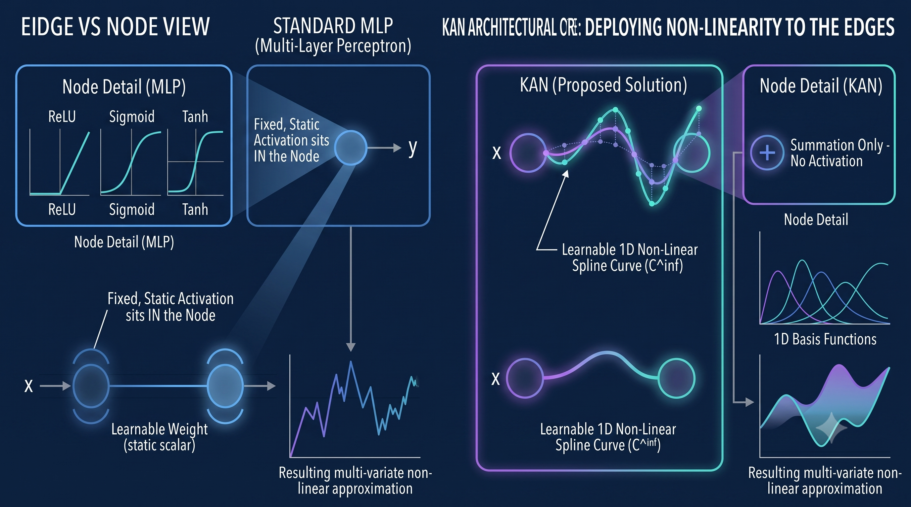
HOW DOES KAN COMPARE?
E
(Kolmogorov-Arnold Network)
Notes:
What is KAN. Comparison: XGBoost (no gradient), MLP (gradient but black box), KAN (gradient + interpretable). Mini node diagrams show sigma on nodes (MLP) vs spline on edges (KAN).

Slide 11
HOW DOES KAN COMPARE?
E
(Kolmogorov-Arnold Network)
XGBOOST (WHAT WE HAVE)
MLP / PLAIN NEURAL NET
KAN (WHAT WE ADD)
Differentiable?
NO
Differentiable?
YES
Differentiable?
YES
Interpretable?
Rank only
Interpretable?
NO (black box)
Interpretable?
YES (plot curves)
Inverse search
Needs slow
diff evolution
Inverse search
Possible but
untrustworthy
Inverse search
Fast gradient
+ uncertainty
Trust?
Limited
Trust?
Hard to verify
Trust?
Cross-check physics
Notes:
What is KAN. Comparison: XGBoost (no gradient), MLP (gradient but black box), KAN (gradient + interpretable). Mini node diagrams show sigma on nodes (MLP) vs spline on edges (KAN).

Slide 12
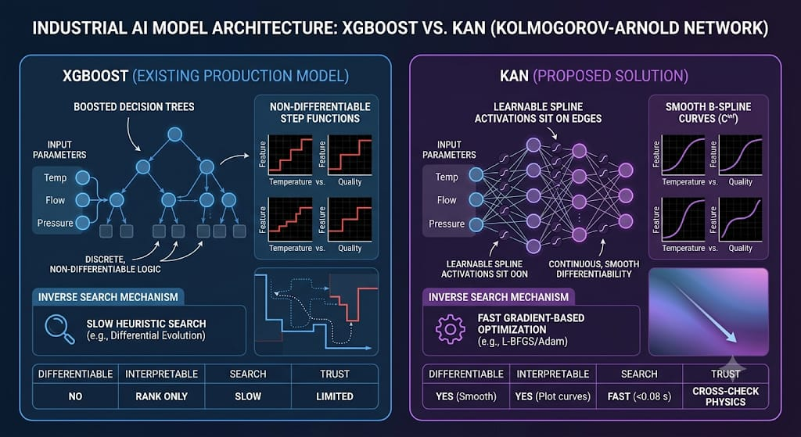
HOW DOES KAN COMPARE?
E
(Kolmogorov-Arnold Network)
Notes:
What is KAN. Comparison: XGBoost (no gradient), MLP (gradient but black box), KAN (gradient + interpretable). Mini node diagrams show sigma on nodes (MLP) vs spline on edges (KAN).

Slide 13
HOW KAN NOVEL?
Objective: one differentiable, interpretable model that improves forward prediction, inverse recipe search, and trust at once.
HOW KAN SOLVES EACH PROBLEM
WHY KAN SPECIFICALLY
1. KAN is differentiable end to end. We get true analytic gradients, so inverse recipe search uses fast L-BFGS / Adam instead of slow differential evolution, and multi-start runs give an uncertainty band on the recommended recipe.
2. One nonlinear model replaces the PLS linear inverse: it handles nonlinear HiPCO relationships and all inputs simultaneously.
3. KAN spline activations show the actual shape of each input-to-quality relationship, which we cross-check against known HiPCO physics.
XGBoost: interpretable-ish but NOT differentiable. Bad for inverse.
Plain MLP: differentiable but a black box. Bad for trust.
KAN: the ONLY model that is both differentiable AND interpretable. Exactly what an invertible, trustworthy process model needs.
Notes:
How KAN fixes all 3 problems. KAN is the only model both differentiable and interpretable. Execution plan reuses existing pipeline.

Slide 14
PROJECT PHASES AT A GLANCE
Seven phases from foundation to submission
1
Foundation & Literature
5 papers reviewed, novelty pinned, venue chosen, isolated package set up.
DONE
2
Dataset Preparation
One row per batch from our available data: 7 setpoints + 11 physics-engine features + DWM lab targets.
DONE
3
KAN Forward vs Baselines
Train KAN; benchmark against existing XGBoost and PLS on identical CV splits (R2, NMAE).
NOW
4
Differentiable Inverse
Gradient-based recipe search with feasibility penalties; replaces differential evolution and SLSQP.
NEXT
5
Ablations & Interpretability
Spline-activation plots for top inputs; cross-check shapes against known HiPCO physics.
NEXT
6
Figures & Paper Draft
Architecture, forward-vs-inverse, interpretability figures; IEEE draft.
NEXT
7
Review Prep & Submission
Preempt objections, confirm no proprietary values, format, submit.
NEXT
Notes:
All 7 phases on one slide. Phase 2 = dataset preparation, not synthetic generation.

